Slide 1
Loan Prediction using Machine Learning
Logistic Regression

Slide 2

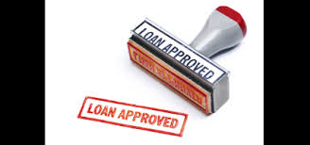
Problem Statement & Solution Overview
Problem : Binary classification problem to build a loan approval pre-check system for potential customers.
Solution : Train a machine learning model using Logistic Regression to predict weather a candidate is good for loan or not.

Slide 3
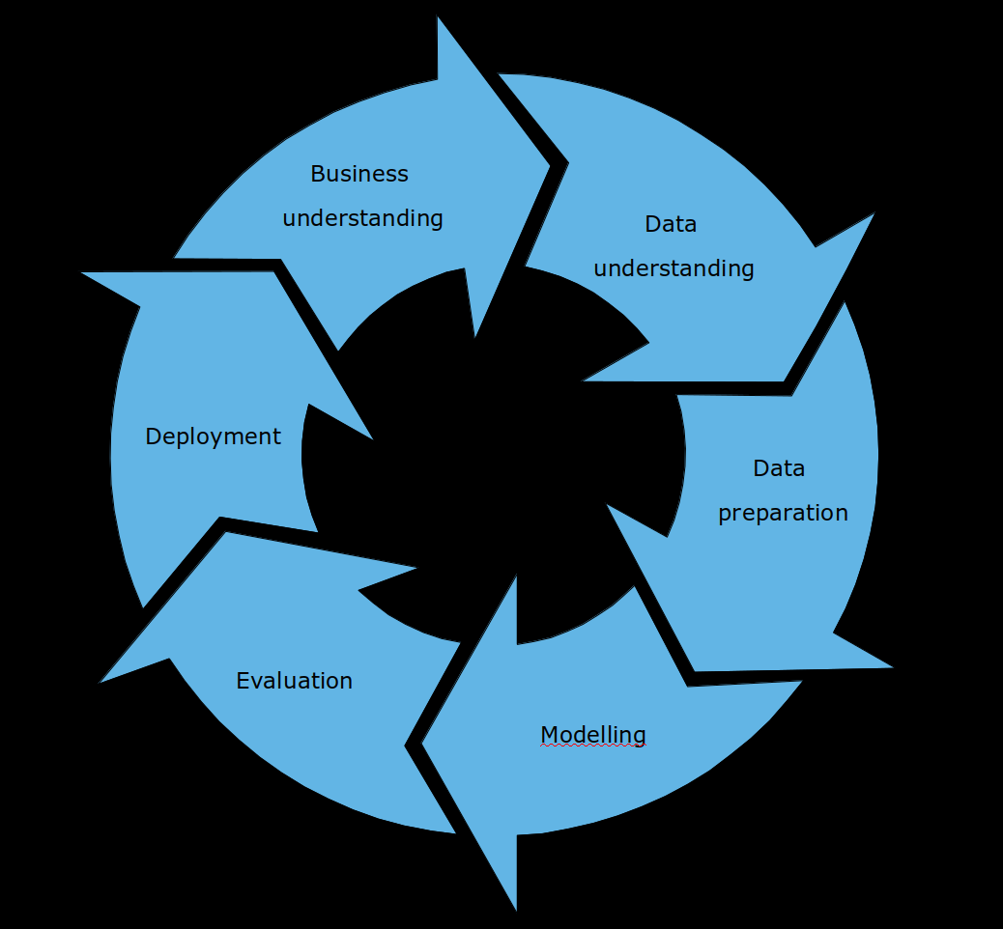
Approach to Modelling

Slide 4
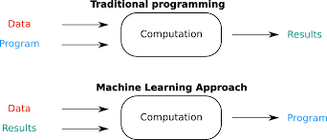
Machine Learning

Slide 5
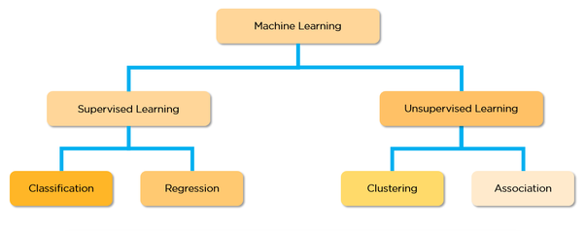
Machine Learning

Slide 6
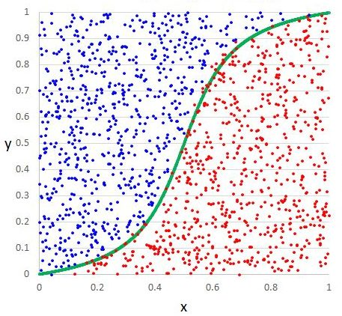
Logistic Regression

Slide 7
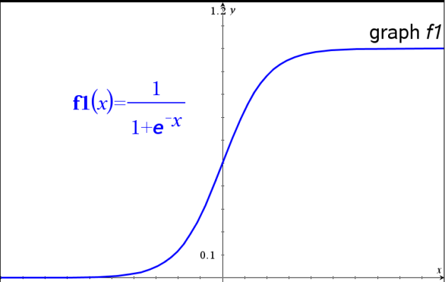
Logistic Regression
Sigmoid Function

Slide 8
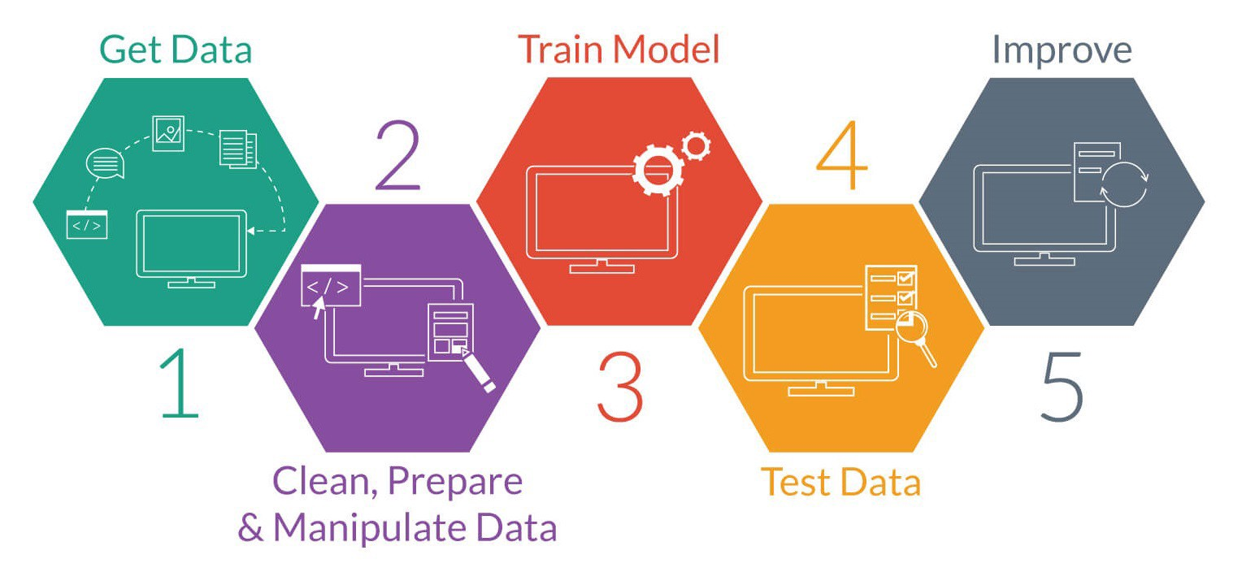
Work Flow

Slide 9
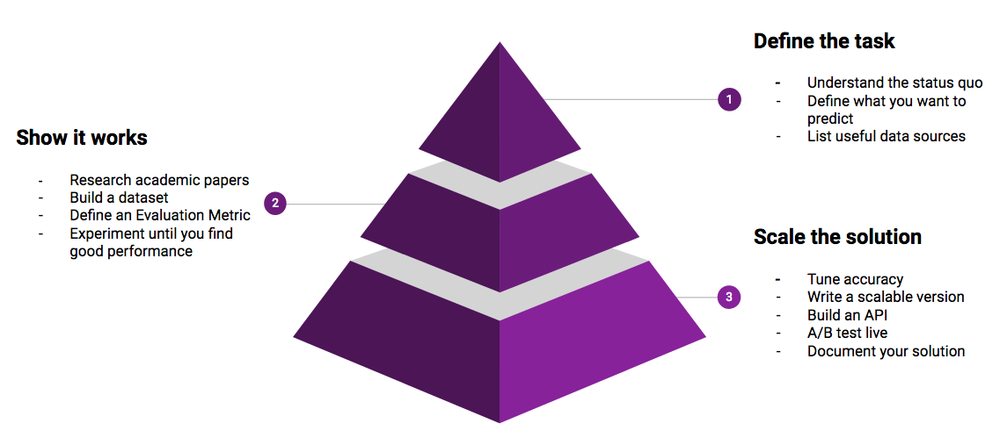
Acquire, Prepare, Analyse Data
In this project , The dataset is used from kaggle.com

Slide 10
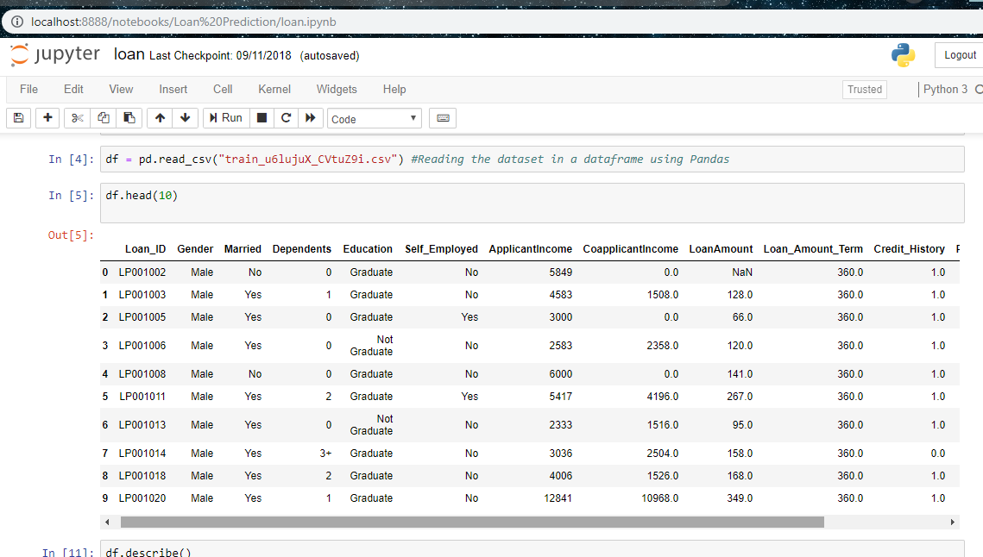
Acquire, Prepare, Analyse Data

Slide 11
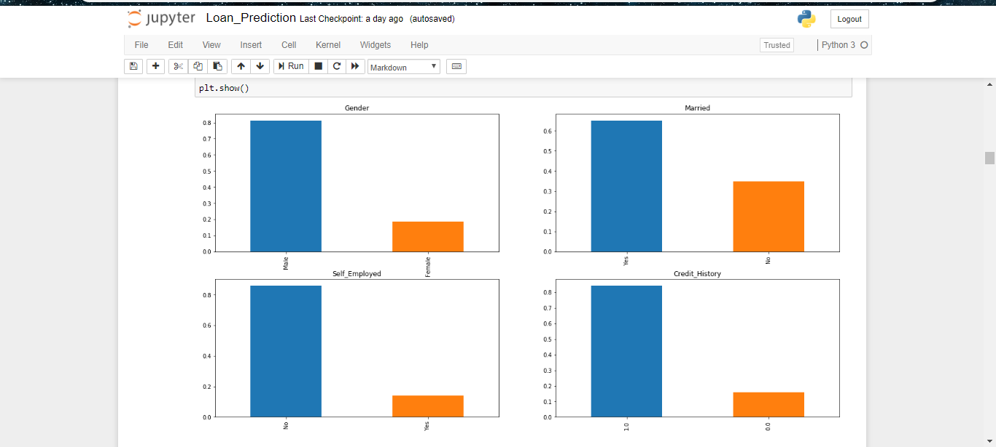
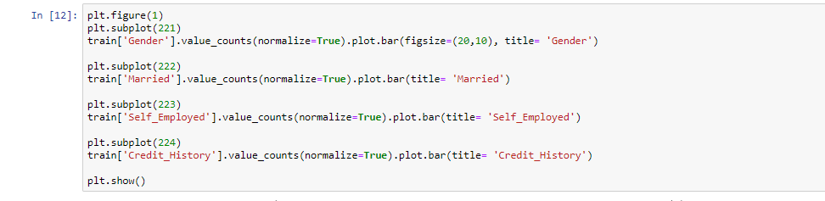
Acquire, Prepare, Analyse Data

Slide 12
Acquire, Prepare, Analyse Data
Jupyter notebook

Slide 13
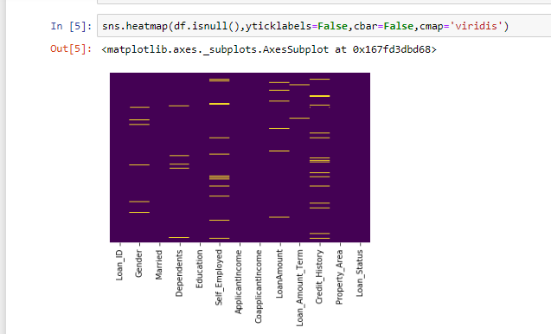
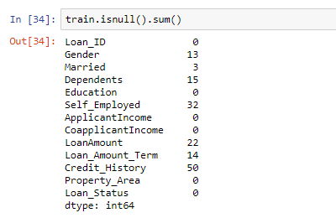
Acquire, Prepare, Analyse Data
Missing features

Slide 14
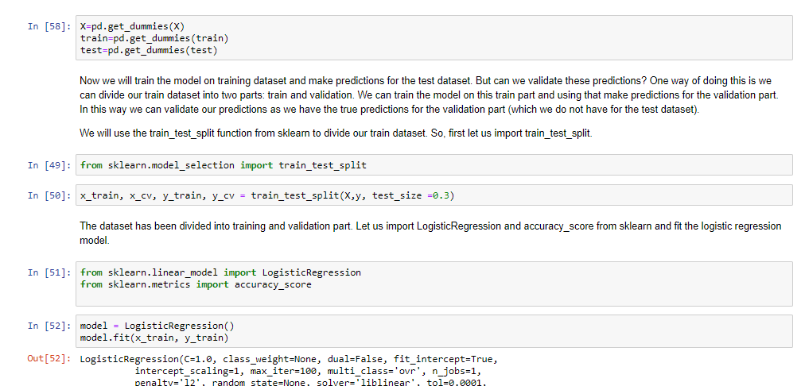
Prepare Data & Develop Model

Slide 15
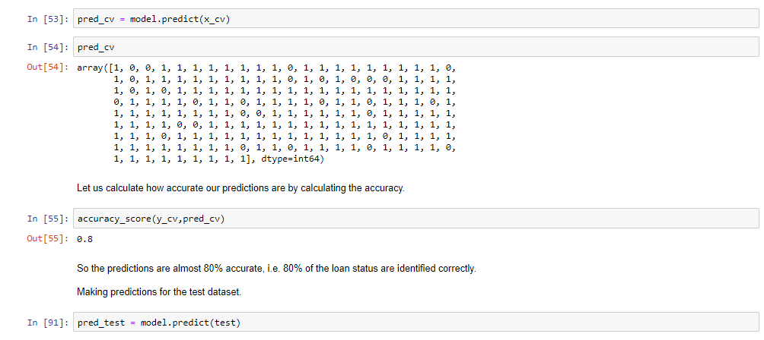
Train, Test & Evaluate Model With Training and Test Data Sets

Slide 16
THANK YOU
Vaibhav Kumar
Aman Sharma

